Slide 1
Strategic Planning Committee (SPC)
Recommendation

Slide 2
SPC History
Where we’ve Been…

Slide 3
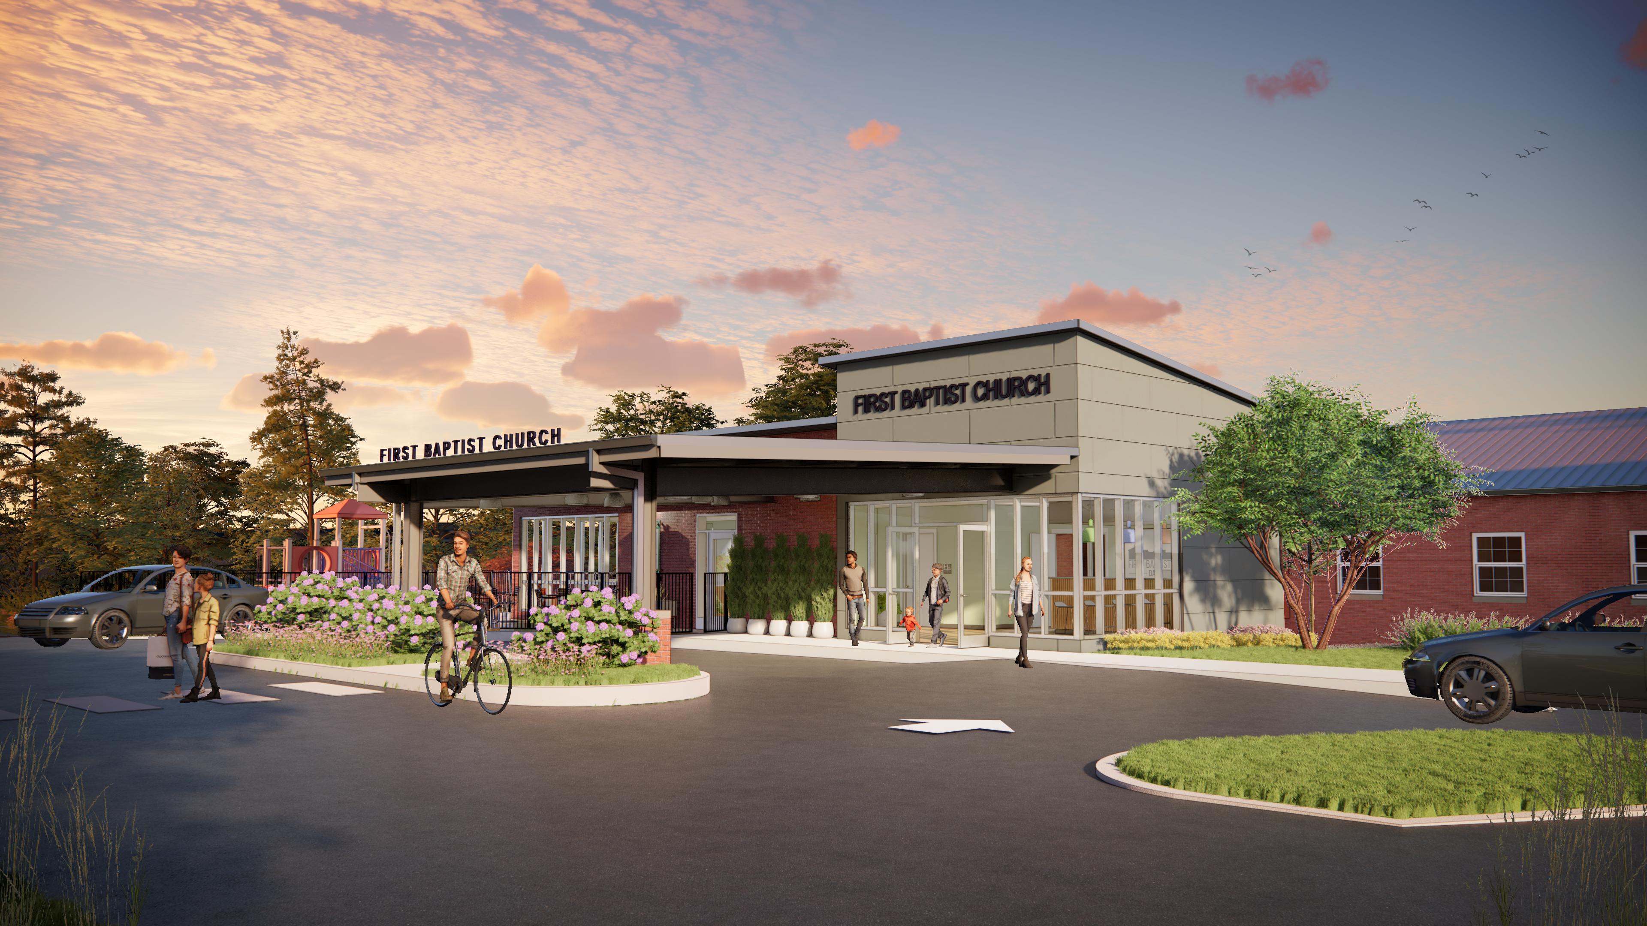
Vision for the Future

Slide 4
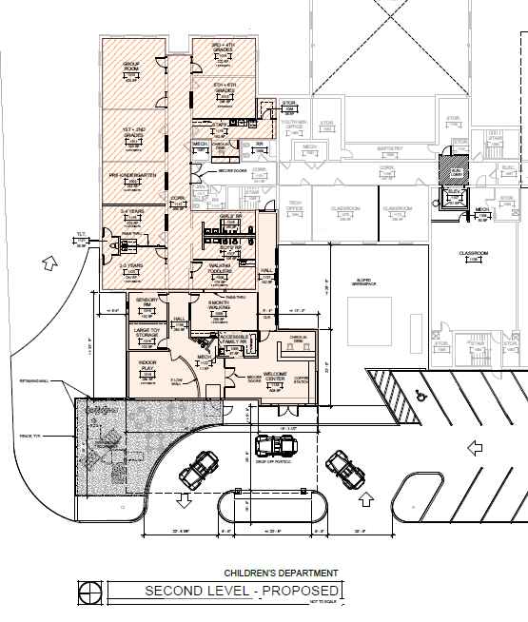
Children’s wing
Upstairs

Slide 5
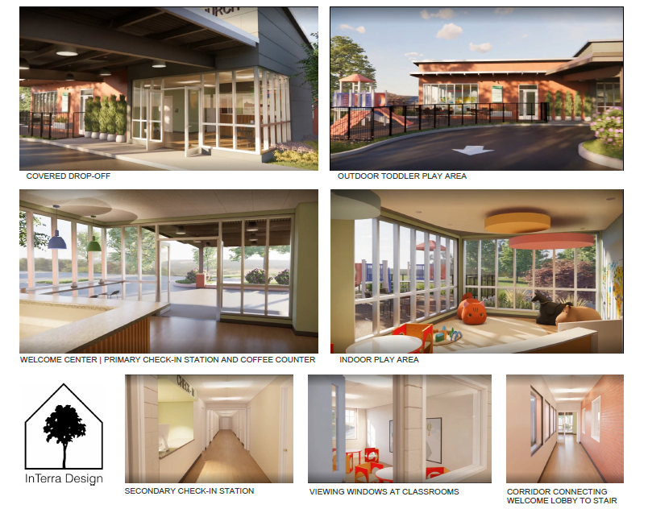

Slide 6
Questions?

Slide 7
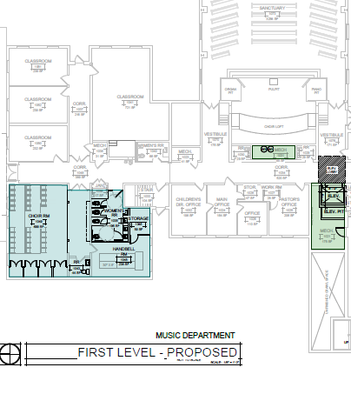
Music Suite
Downstairs

Slide 8
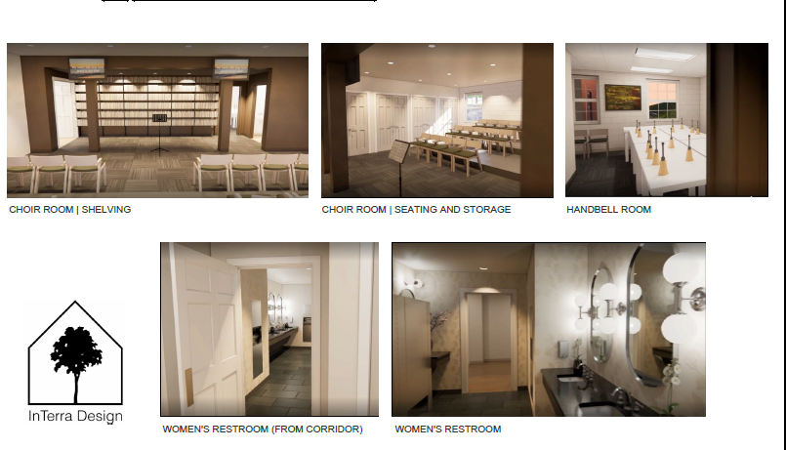

Slide 9
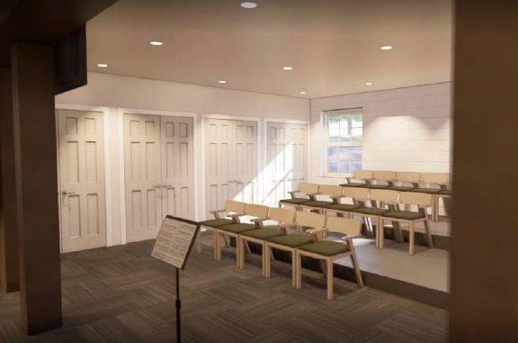
Questions ?

Slide 10
Cost estimate
Received estimates August 2022
Lett Const.- $1,689,637
Bailey Harris- $1,422,017
Average- $1,555,827
Architect fees 10%- $155,582
Misc. internal furnishings 5%- $77,791
Total estimated cost- $1,789,200
    plus 30%-$536,760
Total estimated cost- $2,325,960

Slide 11
Next steps
Pray, Pray, Pray!
Called Conference for voting

Slide 12
Questions or Concerns?
Contact Billy Bryan 256-307-9574

